Slide 1
Remote Sensing of CO2 Evasion from Rivers
!!!??

Slide 2
Why
Network/global-scale evasion estimates are all mean annual values (time-invariant), despite knowing full well that evasion is highly variable at-a-station.
Time-series of GHG evasion from rivers are surprisingly uncommon because it requires a ton of fieldwork.
I’ve only found this type of data for Amazon, Yangtze, and two studies on the Ohio River and York River (Pete)
Thus, no one knows anything about the seasonality of river GHG evasion at large scales, or honestly even outside of the Amazon and Yangtze. BAM-style RS would be a way to directly address this, and to apply it globally

Slide 3
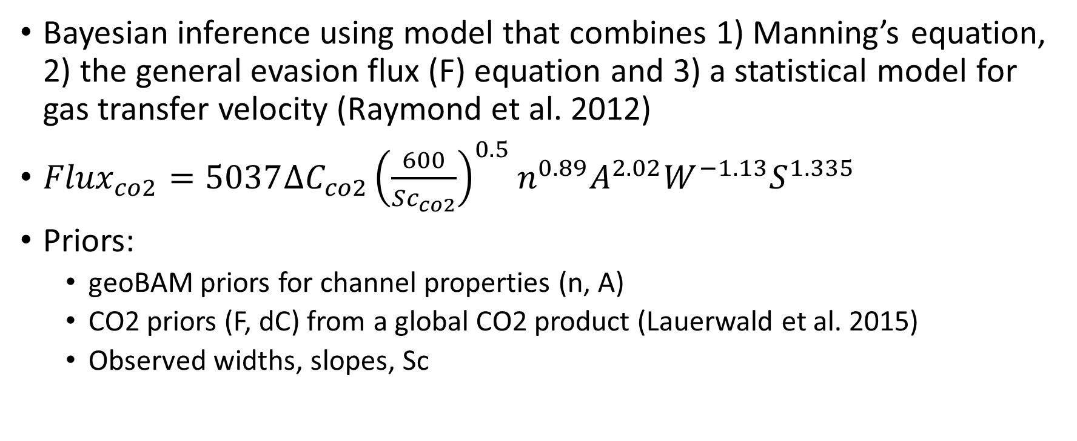
Toy Model
Bayesian inference using model that combines 1) Manning’s equation, 2) the general evasion flux (F) equation and 3) a statistical model for gas transfer velocity (Raymond et al. 2012)
${Flux}_{co2}=5037∆C_{co2}{\left(\frac{600}{Sc_{co2}}\right)}^{0.5}n^{0.89}A^{2.02}W^{−1.13}S^{1.335}$
Priors:
geoBAM priors for channel properties (n, A)
CO2 priors (F, dC) from a global CO2 product (Lauerwald et al. 2015)
Observed widths, slopes, Sc

Slide 4
Validating is tough
Time series of CO2 evasion are few and far between
I don’t have WSE data readily available for rivers with field data
BUT, I found a VERY approximate way to see if I’m on the right track
Field measurements from Ohio River nearly overlap with Pepsi 2 Ohio rivers

Slide 5
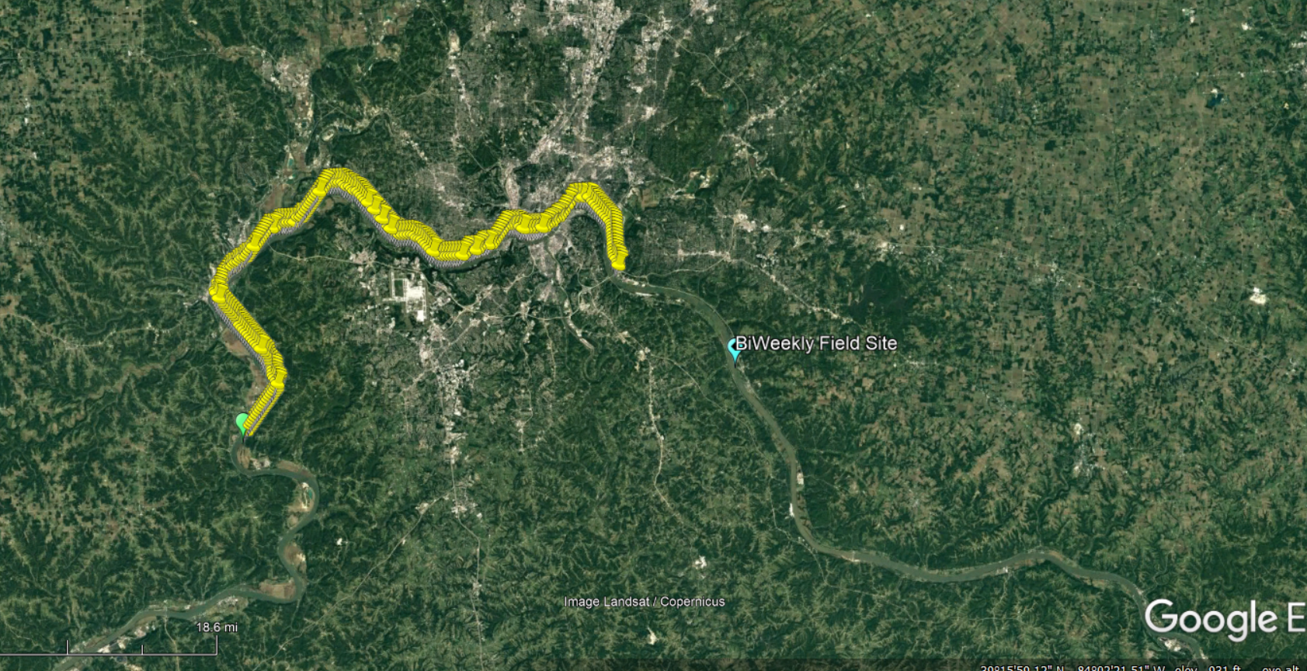
Pepsi2 Ohio Section 1 Cross-sections (January-August 2012)
I used these 15 XS for this test
Bi-Weekly Field Sampling of River CO2 Saturation (August 2008- September 2009)
Beaulieu et al. 2012
Cincinnati!!
I figure running my model on the first few XS, even though it isn’t real observations, would give an approximation if I’m on the right track

Slide 6
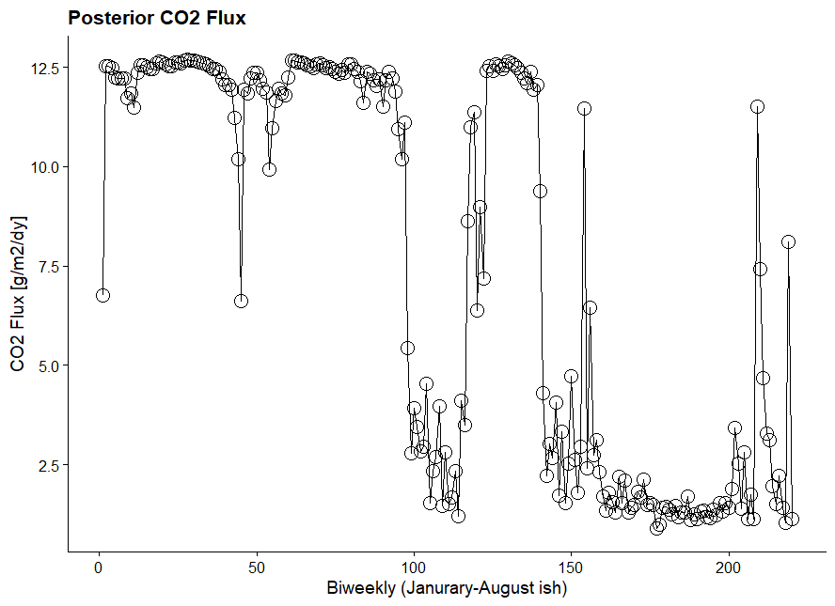
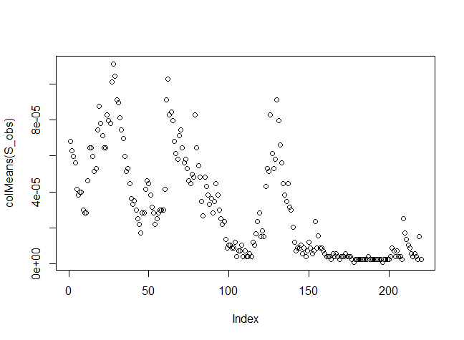
Tracks with big jumps in water surface slope, following surface turbulence dissipation theory

Slide 7
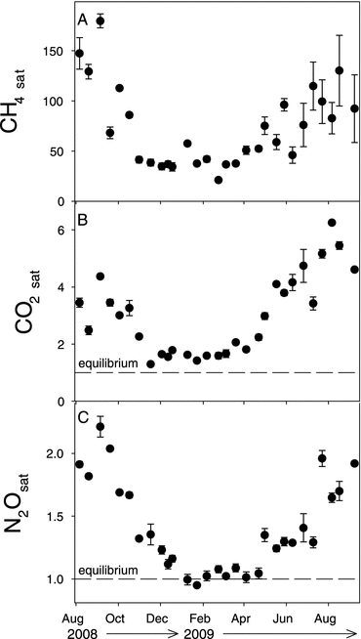
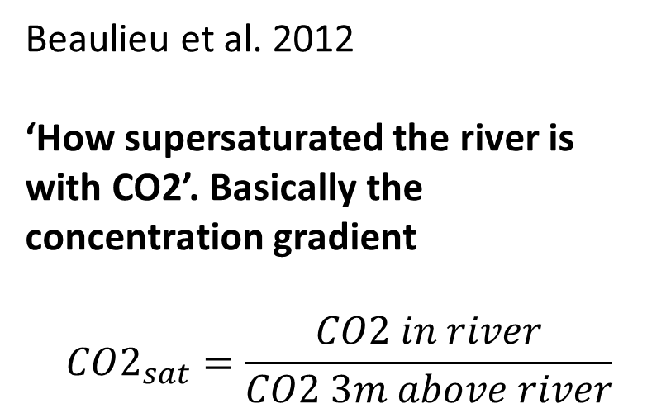
Beaulieu et al. 2012
‘How supersaturated the river is with CO2’. Basically the concentration gradient
$$CO2_{sat}=\frac{CO2 in river}{CO2 3m above river}$$

Slide 8
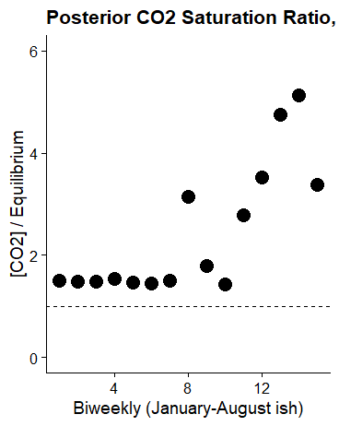
My model results (smoothed biweekly and using constant equilibrium value).
Using just widths and slopes from Pepsi 2 data as observations
Field measurements, not constant equilibrium value (Beaulieu et al. 2012)
Works surprisingly well!!
Coincidence or promising?

Slide 9
What I’ve found
I think I’m on the right track, given that the widths and slopes are just HEC-RAS outputs (for the wrong year and the approx. location)
Looking for a better way to test and validate this
But, need:
time series of CO2 evasion
time series of WSE and width for river reach
Results are super sensitive to prior bounds on gas flux and saturation ratio
Currently set somewhat arbitrarily
85% beyond the 5th and 95th confidence intervals of _hat prior
No idea how to define _sd prior for gas flux or saturation ratio
Currently using a coefficient of variation of 50%

